Slide 1
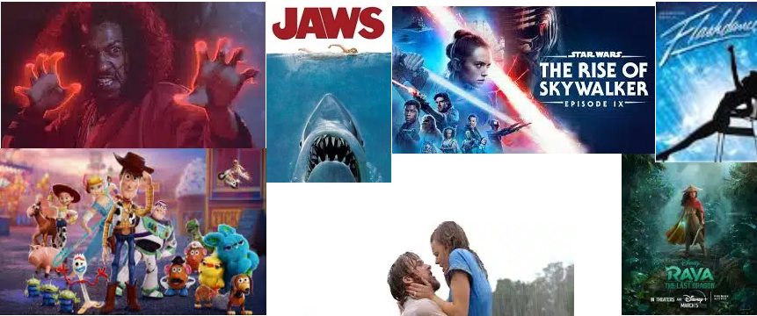
Notes:
JAKE
Welcome and thank you for you time. For your consideration I give you the What the Bleep should I watch Web Application.

Slide 2



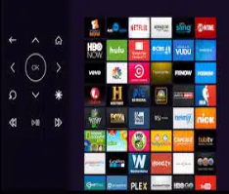

Notes:
JAKE
First world problems, we all have them. Everyone is staying socially distanced due to the age of Covid. What I would like to present to you is a solution for all your viewing needs. As people are staying home more and going out less the main concern seems to be…….What the bleep should I watch? Think about it, all the time we are spending at home with our families, whether you are a cinephile or just enjoy the occasional movie, less and less is becoming available to watch that you haven’t already seen. Our web-based application can provide you with suggestions based on your rating and genre preferences while supplying which subscription services the Title is available to stream on. So now instead of saying what the bleep should I watch go to What the bleep should I watch and explore thousands of movie possibilities based on your preferences. The fancy streaming services don’t always get it right when they make suggestions, so try our application and be amazed at the world of cinematic opportunities it opens.

Slide 3








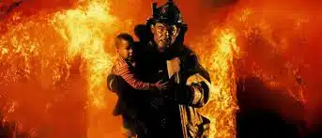



Notes:
SUA
Description
This project is designed to implement the user’s preferences for movies rather than making suggestions based on their previous watch history. The user can exploit this functionality to choose which MPAA (Motion Picture Association of America) ratings they would like to search for. In conjunction with the rating system the user can also choose between 18 different genres, select one or select them all. Your choices are almost infinite. At present this will return the top 5 movies that meet your criteria. After your movie search is complete the user could also search for the movie’s subscription streaming sources, now you’ve got the what to watch and the how.
COLTON
Motivation for Development
Each of us enjoys watching movies, however it is becoming harder and harder to find movies to watch that we haven’t seen 100 times. This would be useful in addition to any streaming service to augment the user’s input, giving them back control of the content.
SUA
USER STORY
I wanted to see an app That would let me choose movie rating dependent on whether I was having a family movie night, a romantic movie night with the significant other or even action movie night with the guys. I also wanted an app that would display the results of any searches I did with my specific parameters which would display a few of the top choices rather than 10,000 movies for me to sift through. I also felt it was important to include where the movies could be viewed on a subscription service, to determine whether they were readily available to me rather than having to be disappointed when searching my streaming service for the title.

Slide 4





Notes:
JAKE
Technologies used
For this project we integrated JavaScript dynamic models with server-side API’s, HTML and a materialize CSS framework to modify the look of the Web Page. JavaScript drives the functionality of our page with fetches, functions and arrays which store the data necessary to bring the page to life and work in the background to complete user queries and display the results. The manipulation of server-side API’s has given us the ability to deliver the contents of not only a large movie database to its users but also the ability to determine what streaming sources can be used to view their selections. The Materialize CSS framework has complimented the buttons and checkboxes to give this page a more uniform look while the HTML provides the basic structure for the document. We have also integrated the use of local storage which will later be used to manage the user’s past preferences to deliver a more rounded viewing experience.
Breakdown of tasks and roles
Tasks were managed throughout the team. Colton provided the basic structure of the document while working on the movie call function inside of the JavaScript. Jacob worked on the server-side call functions for the Streaming services content and SUA worked on the CSS design of the page. This was the original delegation of responsibilities. The team came together to work through issues that we faced with the individual tasks to adapt and overcome obstacles together to complete the project by the deadline.
COLTON
Challenges
Challenges were met with frustration by all 3 team members as we ran into obstacles. The most difficult part of managing the team project was coordinating 3 different schedules to get the project over the finish line. The other challenge was looking at the project as a whole rather than its individual pieces.
SUA
Successes
Successes came when we were able to collaborate as a team on individual issues. Different perspectives gave us a better understanding of what we needed to accomplish to complete the task at hand. Helping each other and reaching out when necessary to obtain guidance from the instructors and TA’s was also key in understanding some of the concepts and ideas we were trying to apply. The nudge or push in the right direction gave us the motivation to continue with the project when we were struggling. Getting the project completed when at times the odds felt insurmountable was our second largest success. The first was our individual contributions and collaboration.
Technologies used
Breakdown of tasks and roles
Challenges
Successes

Slide 5
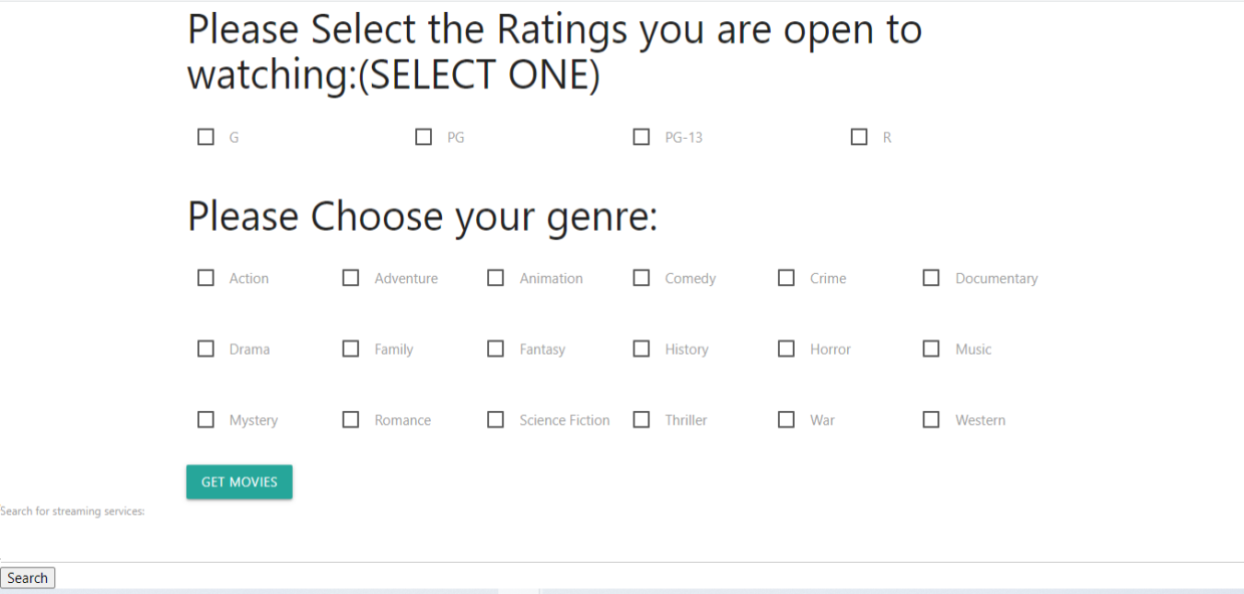
Notes:
COLTON
We will now demonstrate the functionality and necessity of our web application.

Slide 6




Notes:
SUA
Directions for Future Development
The design team has already discussed future implementations to address the appeal of the website and add additional features. Currently we are trying to implement the ability for our users to see their past queries which in turn will give them the ability to see which genres and ratings they may have been missing out on to broaden their cinematic horizons.
There have also been discussions of giving users the ability to choose by review rating because hey, sometimes we are looking for a good “B” movie. Users will have the ability to search for critically acclaimed movies which will be rated at or above a certain level TBD, or below a certain level TBD.
JAKE
To increase the appeal of the webpage functionality from our API will allow us to display movie posters rather than just a lit of random movies fitting their search criteria.
We also plan to merge the functionality of the streaming service search and the movie search to display all search results at the same time making the application easier for the user to interface with.

Slide 7
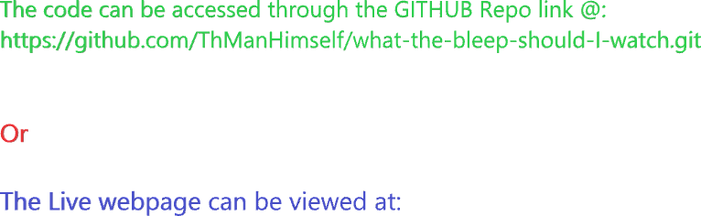
Notes:
COLTON

Slide 8

Notes:
GROUP
Q/A - 3 Minutes

